Slide 1
TRENDAMERICA
C A L I F O R N I A R E S I D E N T I A L L A N D D E V E L O P M E N T
I N V E S T M E N T O P P O R T U N I T Y
20% Preferred Return
With additional uncapped upside through a performance-based profit structure
WHY NOW? CALIFORNIA'S HOUSING SHORTAGE CRISIS
California has accumulated an unmet housing backlog of nearly 2 million units
and must provide at least 180,000 new homes annually — yet only about 80,000 are built each year.
Homebuilders are racing to acquire entitled land, and TrendAmerica delivers it.
OUR FOUR-STEP MODEL
1
2
3
4
CONTROL IT
ENTITLE IT
SELL IT
DISTRIBUTE
Secure land via option agreement — not ownership
Navigate City/County subdivision map approval process
Flip entitled land to homebuilder via double escrow
Return capital and profits to investors under the project structure
50+
20+
2,550+
$1.3B+
Years Combined Experience
Subdivision Projects
Lots Entitled
Transaction Volume
WHY INVEST WITH TRENDAMERICA?
● No Shovels in the Ground ●
● We Know The Builder’s Numbers ●
We create "Paper Lots" — approved subdivision maps — without construction.
The builder takes the development risk, not our investors.
Our project financial analysis proforma mirror theirs, giving us a decisive advantage in negotiating land acquisitions and sales to California's premier builders.
● Investor-Aligned Structure ●
● California Is Our Advantage ●
We earn our profit share only after investors receive their 20% preferred return, so we're driven to push every project's return as high as possible.
When you win, we win.
The most regulated state is the highest-barrier market — fewer competitors for those who know it.
Our principals have spent decades mastering
the state’s entitlement process.
See If You're a Fit
We partner with a limited number of accredited investors on each project. Reach out to learn more, confirm your eligibility, and see whether this is the right fit for your portfolio.
Call (619) 329-1350 Email info@TrendAmericaLand.com Visit TrendAmericaLand.com
$20,000 minimum per project • Accredited investors only
SEE REVERSE FOR ADDDITIONAL INFORMATION

Slide 2
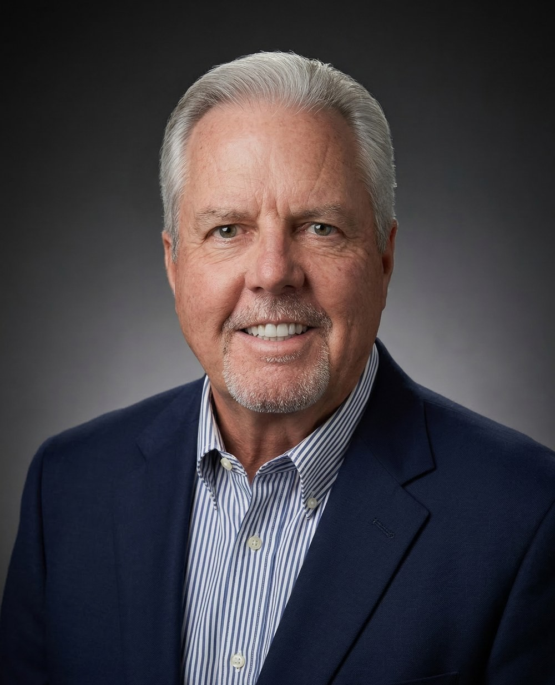
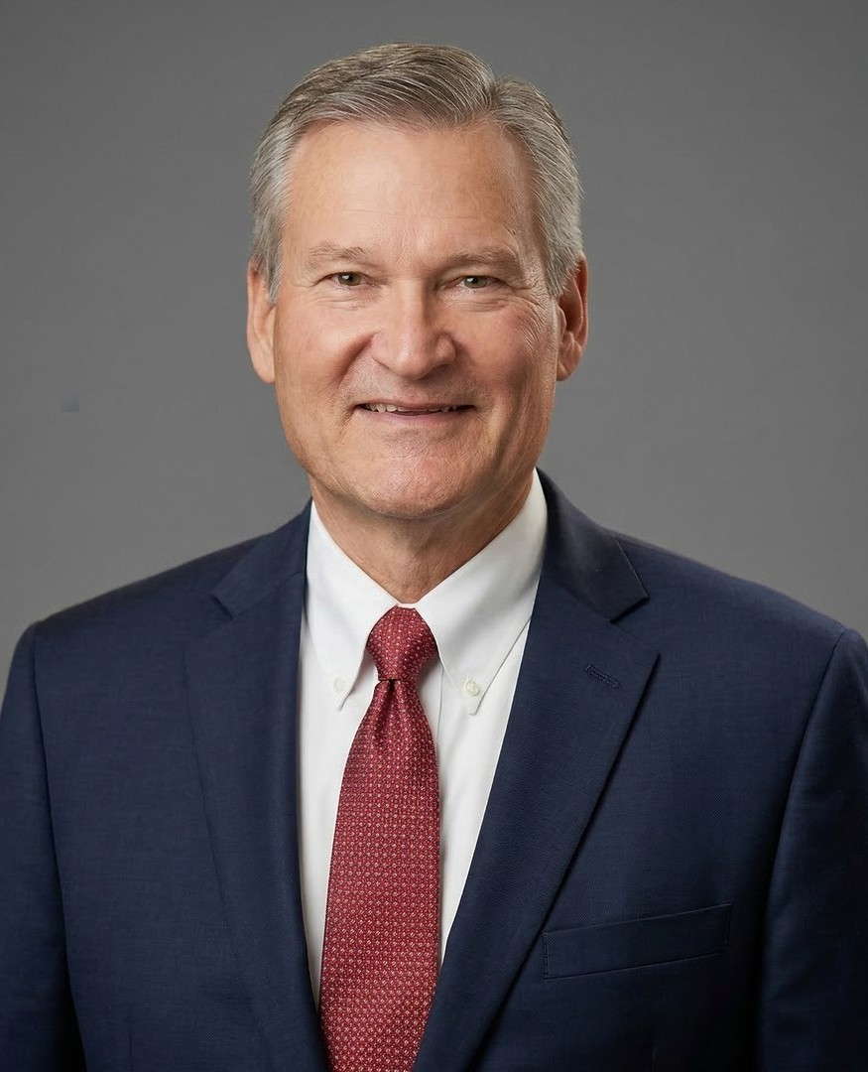
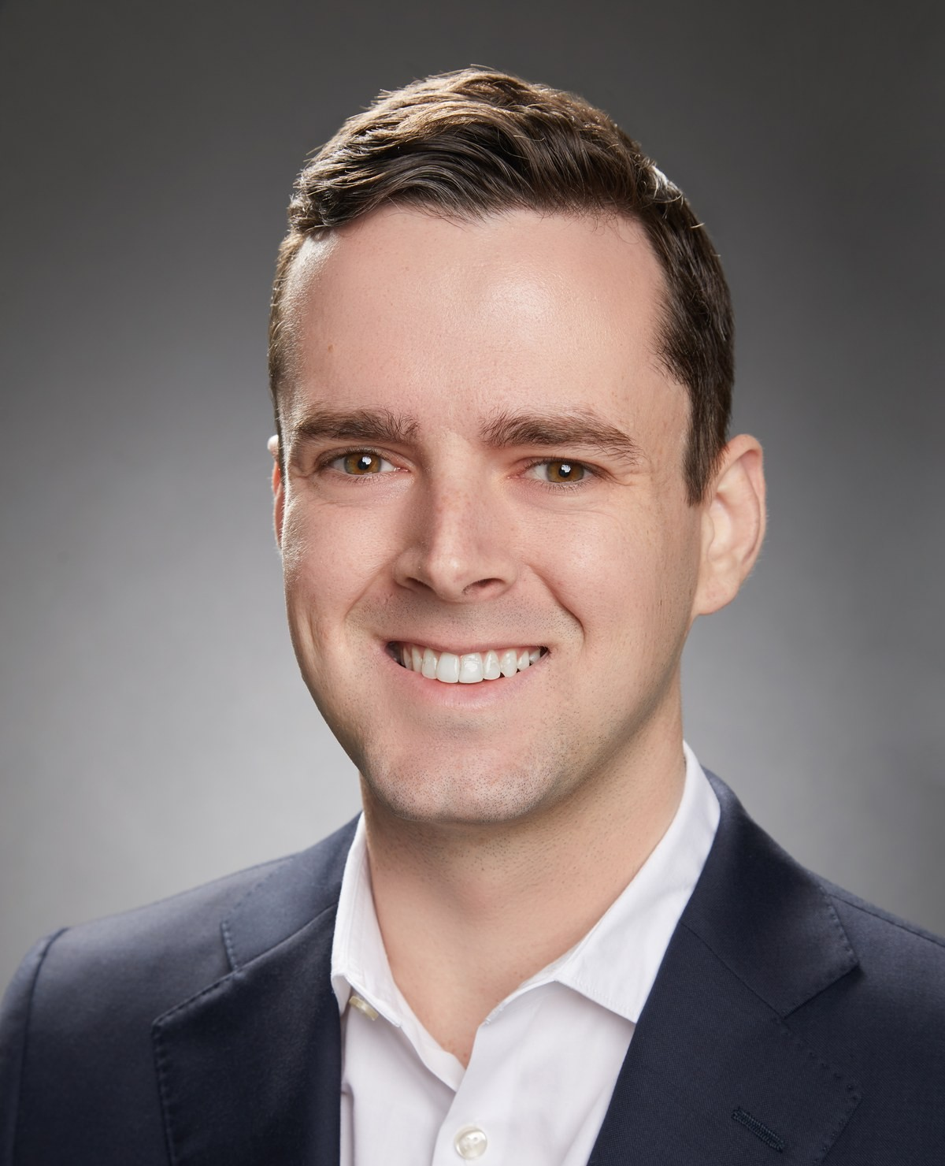
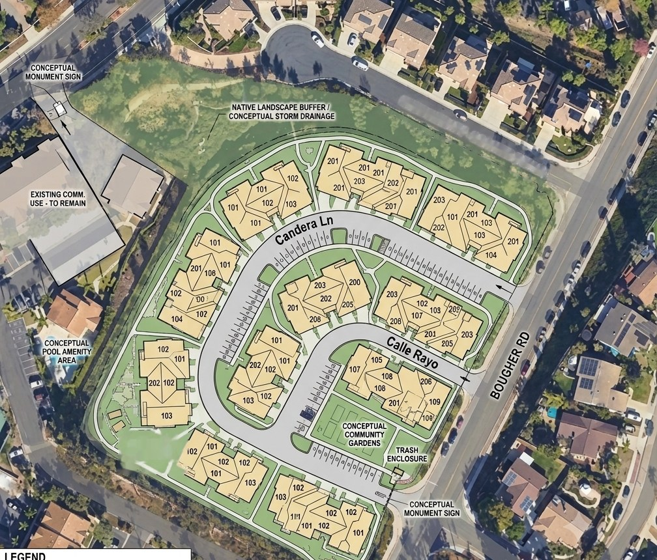
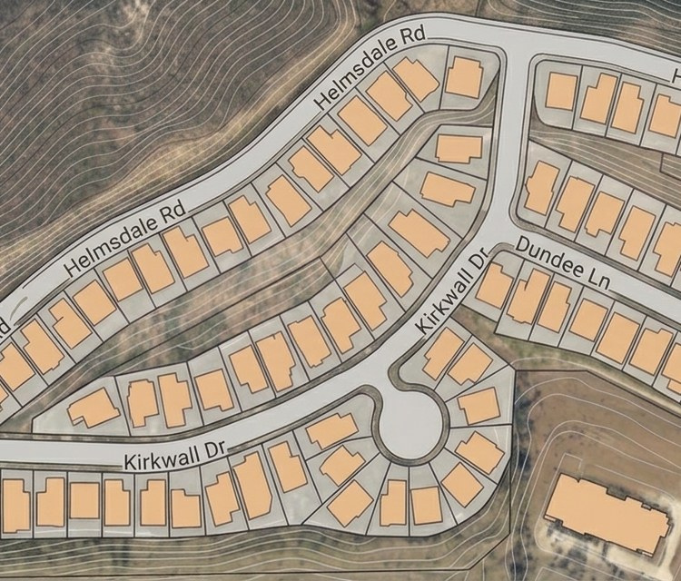
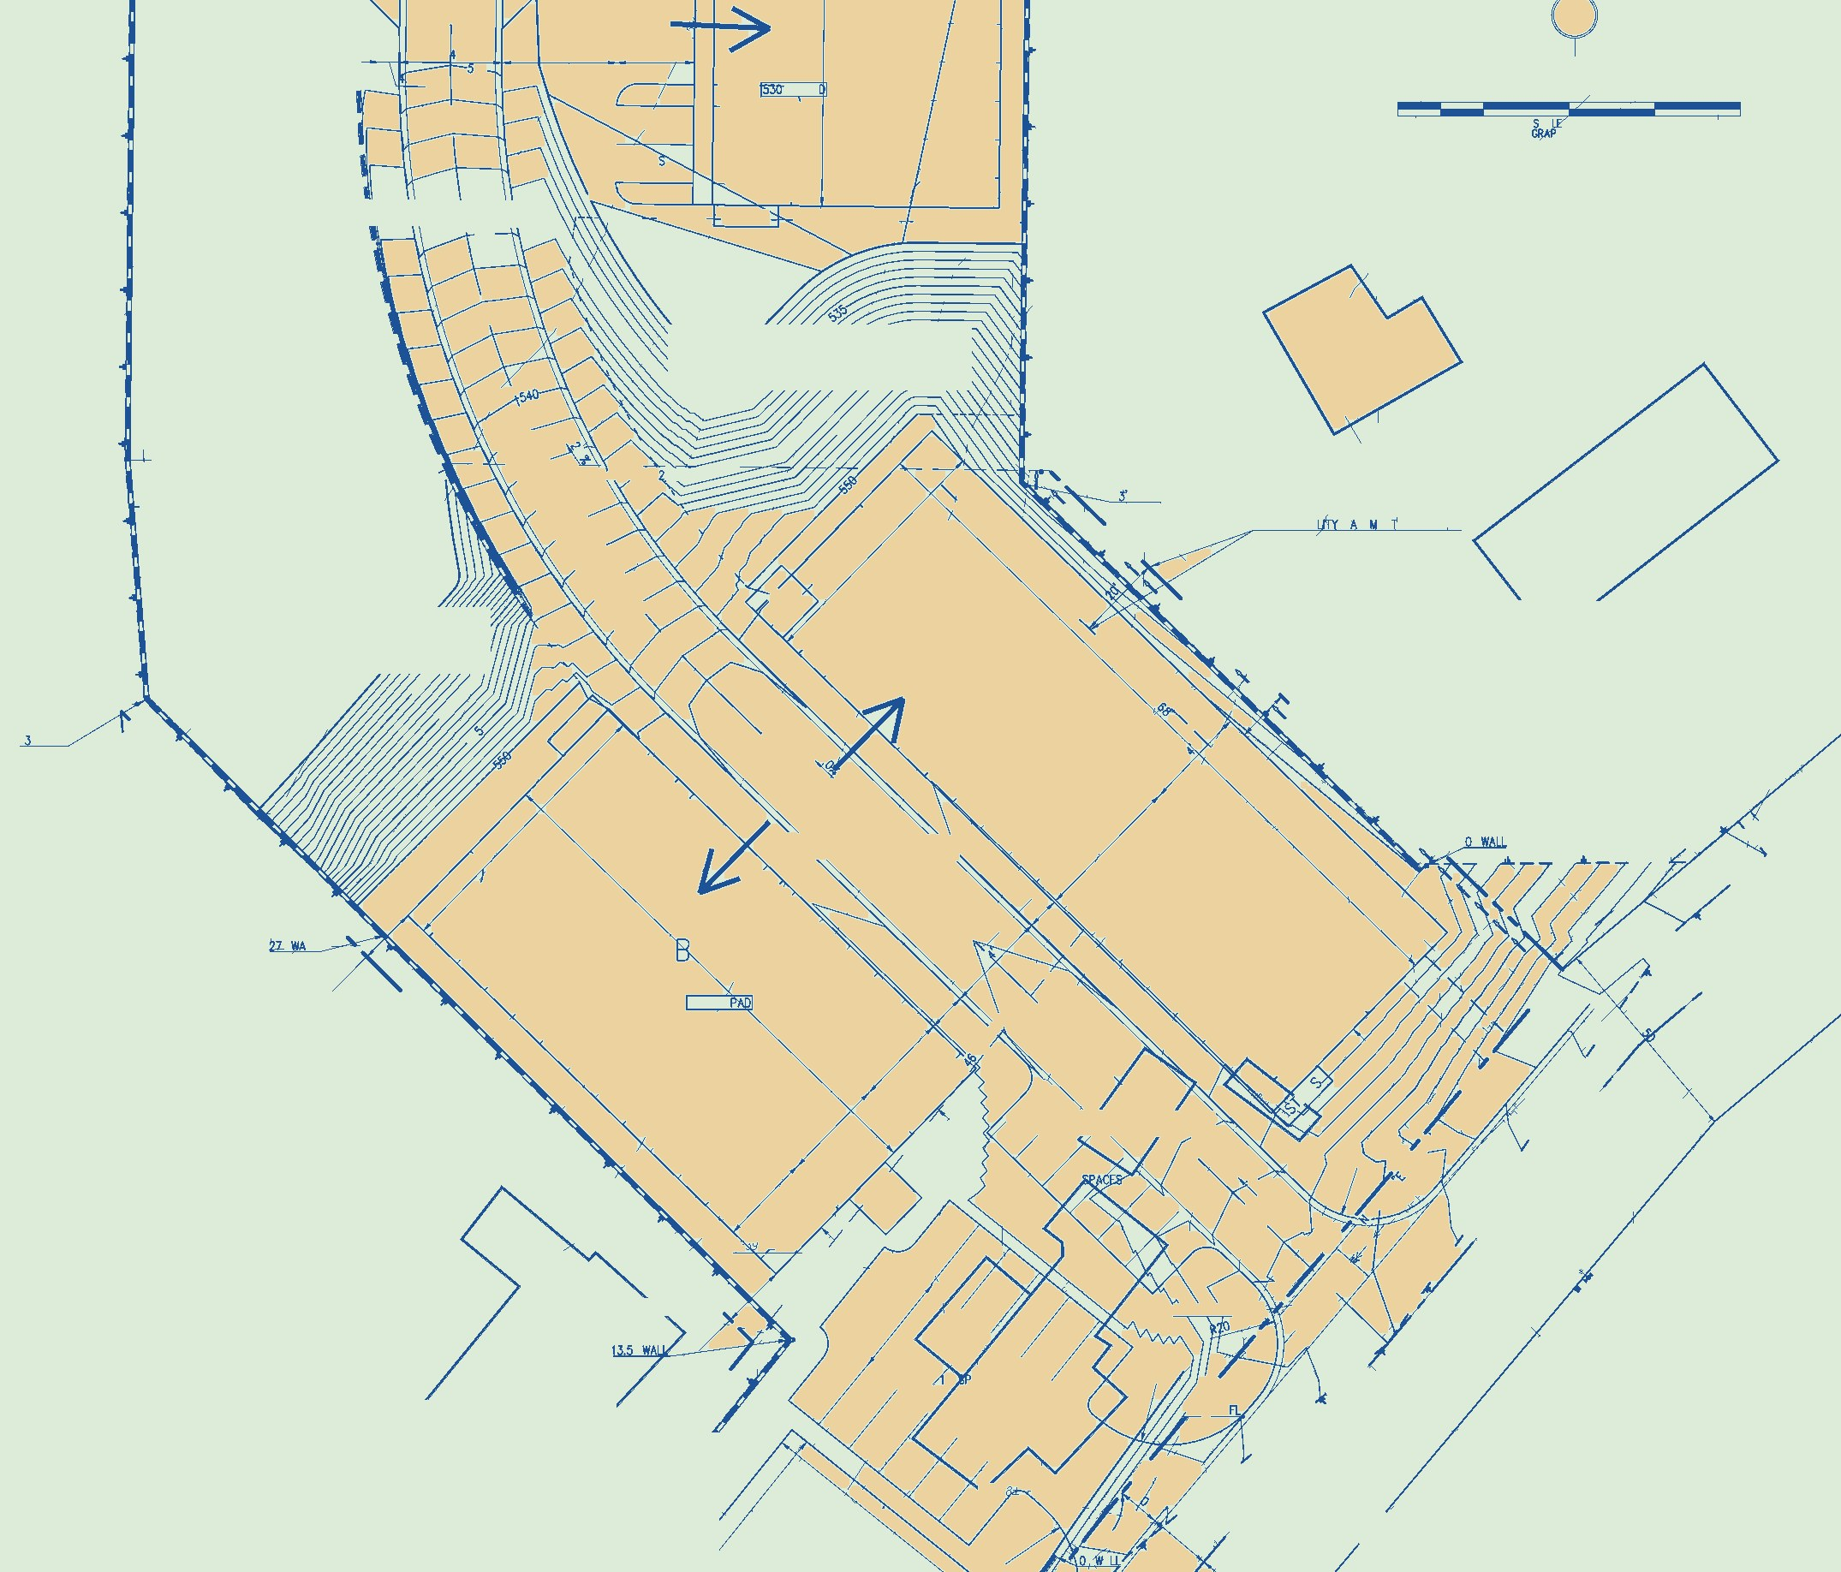
TRENDAMERICA
M E E T O U R L E A D E R S H I P T E A M
RANDY REINHART
MARK GOODMAN
DANE REINHART
President
VP, Entitlements
VP, Finance
Former EVP of Land Acquisitions & Entitlements at KB Home and SVP at K. Hovnanian Homes. Recruited by former U.S. Secretary of Housing Henry Cisneros to lead an infill land development joint venture. Over $500M in land transactions and 2,550+ lots, 20 projects across California and Nevada.
Senior Project Planner & Environmental Analyst, Orange County Planning Dept. Director of Entitlements, KB Home. Director of Development, Shapell Homes. Elected to Laguna Niguel City Council; served as Mayor. Board member, OC Fire Authority & Transportation Corridor Agencies.
Institutional real estate finance professional with nearly a decade at Hayden Properties, Presidium, and Balboa Real Estate Partners. Led projects totaling $800M+ in transaction volume and 18,000+ units managed. Expert in proforma modeling, Return on Investment analysis, and investor reporting.
● JD, University of Arkansas School of Law
● BA Business, UC Riverside
● Licensed RE Broker — CA & AZ
● Former CA General Contractor
● MPA Urban Planning, CSU Fullerton
● BA Political Science, Cal Poly Pomona
● Acting Planning Director, City of Norwalk
● CEQA, Army Corps & Water Quality Expert
● MS Finance, SMU Cox School of Business
● BA Economics, Arizona State University
● Acquisitions & Asset Management
● Return on Investment & Cash Flow Analysis
SELECT PROJECTS & SITE PLANS
Add 4th
project image
Bougher Road — Vista
Aberdeen Ave — San Marcos
Noll Property — Vista
This material is for informational purposes only and is not an offer to sell or a solicitation of an offer to buy any security. Securities are offered only to accredited investors, and only by means of a Private Placement Memorandum and related subscription documents for a specific project. Investments in land entitlement are speculative, illiquid, and involve a high degree of risk, including the possible loss of the entire investment. Any returns described, including the preferred return, are targets and are not guaranteed. Past performance, including the prior experience of TrendAmerica's principals at other companies, does not indicate future results. Forward-looking statements are subject to risks and uncertainties and may not occur. No federal or state securities regulator has approved this offering or these materials. TrendAmerica is not a registered broker-dealer or investment adviser. Prospective investors should consult their own legal, tax, and financial advisors.
READY TO LEARN MORE?
Reach out by phone or email: (619) 329-1350 | info@TrendAmericaLand.com
www.TrendAmericaLand.com • California Residential Land Development

